Slide 1
STATISTICAL
METHODS FOR
DATA SCIENCE
VIOLET MICHELLE ANNE LAW ARANCE

Slide 2
TABLE OF CONTENTS
ABOUT THE COMPANY & DATA USED
PROBLEMS & OBJECTIVES
01
02
03
DESIGN
TECHNIQUES
04
DASHBOARDS & DEMOS
-Introduction on the background of the company and the dataset
- Problem Statement and goals of this research
-Design principles used
-Explanation and demonstration of the dashboards in Tableau

Slide 3
01
ABOUT THE DATASET

Slide 4
BACKGROUND OF THE COMPANY
XYZ Insurance Company is a private insurance company that is based in Malaysia and has multiple branches worldwide.
Private Limited Company
Primarily focuses on services in various insurance products:
1. International and Domestic Travel Insurance
2. Motor Insurance
3. Personal Insurance etc.
Company Values:
Commitment, Service Excellence, Adaptability

Slide 5
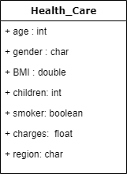
DESCRIPTION OF THE DATASET
Dataset obtained from Kaggle
Healthcare Medical Costs
Fields that are usually stored in the healthcare database
1338 instances and 7 columns
Contains personal information that is obtained from a random community of people between the age of 18 to 64

Slide 6
02
OBJECTIVES

Slide 7
OBJECTIVES
Identify the correlation between bmi and the charges of the medical
Identify the relation between smoker, and the charges of the medical
Identify the relation between age and the charges of the medical
Build a predictive model to predict the medical charges

Slide 8
03
SUMMARY

Slide 9
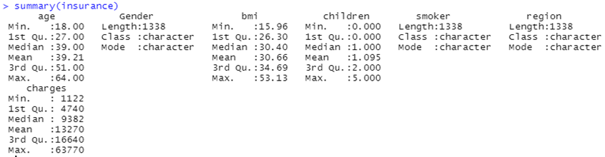
Variables age, bmi, children and charges are integers and variables such as gender, smoker and region are Boolean and categorical.
The min and max values of a data are sensitive to outliers. Identifying outliers through min and max is important as it can affect the mean value of the data by skewing the results.

Slide 10
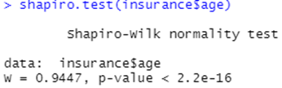
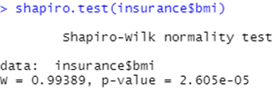
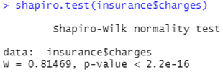
KEY FINDINGS
The average age is 39 years old, standard deviation of 14 years old,
Testing of normality via Shapiro-Wilk test yields, p-value < 0.05, data is not normally distributed.
The average bmi is 30.66, standard deviation of 6.09
Testing of normality via Shapiro-Wilk test yields, p-value = 0.05, data is normally distributed.
The average charge is RM13270, standard deviation of Rm12110
Testing of normality via Shapiro-Wilk test yields, p-value < 0.05, data is not normally distributed.

Slide 11
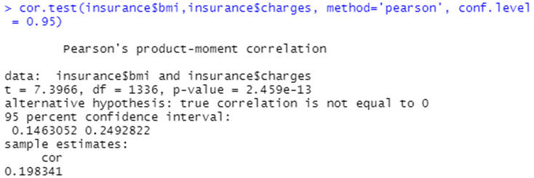
KEY FINDINGS
Pearson Correlation determine the linear correlation between two variables
H₀: β=0 or there is no relation between BMI and medical charges
H₁: β≠0 or there is a relation between BMI and medical charges
We conclude that the data provide sufficient evidence to conclude that the bmi has a significant association with charges.

Slide 12
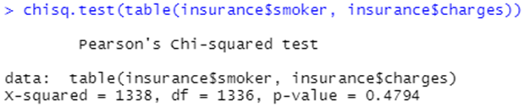
KEY FINDINGS
Pearson Correlation determine the linear correlation between two variables
H₀: β=0 or there is no relation between smoker and medical charges
H₁: β≠0 or there is a relation between smoker and medical charges
A Chi -Square Test is a statistical test for categorical data. A significance level of α = 0.05 is used for this hypothesis test. At the 5% significance level, the null hypothesis is rejected since p-value 0 =0.4.

Slide 13
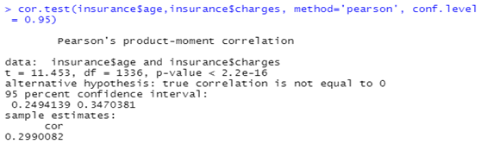
KEY FINDINGS
Pearson Correlation determine the linear correlation between two variables
H₀: β=0 or there is no relation between age and medical charges
H₁: β≠0 or there is a relation between age and medical charges
We conclude that the data provide sufficient evidence to conclude that the age has a significant association with charges.

Slide 14
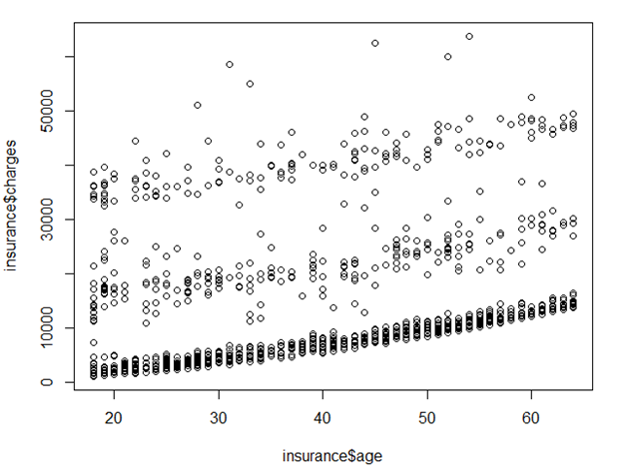
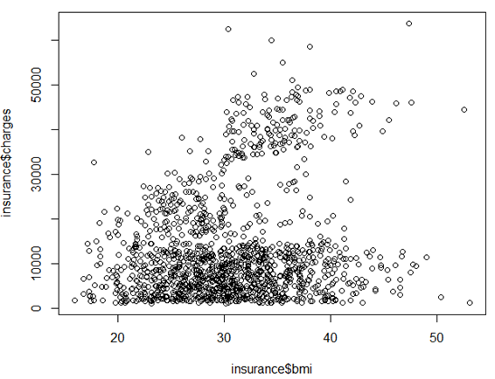
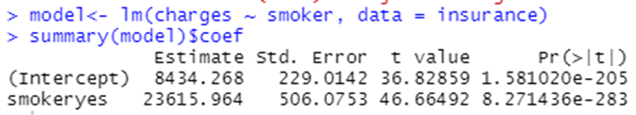
KEY FINDINGS
There is a high correlation age and charges
Pattern between the variable BMI and charges cannot be recognized, but an increase in BMI shows some correlation to charges
Smoking does have an influence on medical charges.

Slide 15
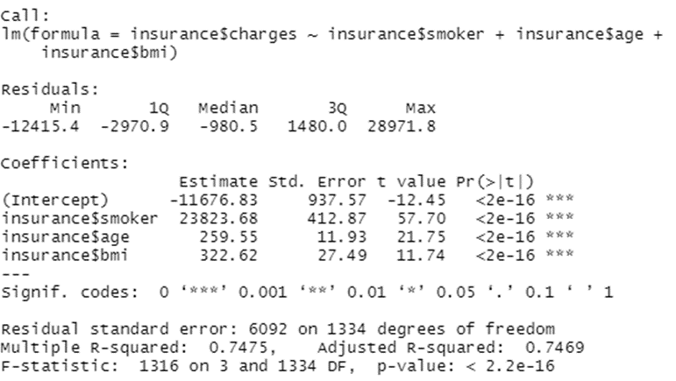
MULTIPLE LINEAR REGRESSION
Predictor formula = smoking + age + bmi
Multiple R-squared is 0.7475
74.75% of the variation in the response variable around its mean
adjusted R-Squared is almost like the multiple R-square
the model is good, and the predictor variables are all significant
charges = -11676.83 + (238223.68 * smoker) + (259.55 * age) + (322.62 * BMI) + error.

Slide 16
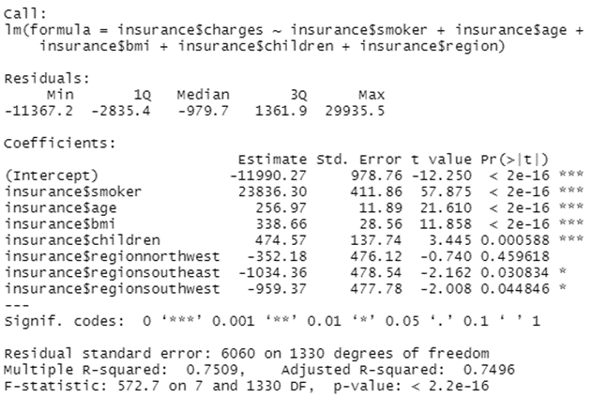
MULTIPLE LINEAR REGRESSION
Predictor formula = smoking + age + bmi +gender + children + region
Multiple R-squared is 0.7475
75.09% of the variation in the response variable around its mean
Gender not significant
multiple R-squared value is the same

Slide 17
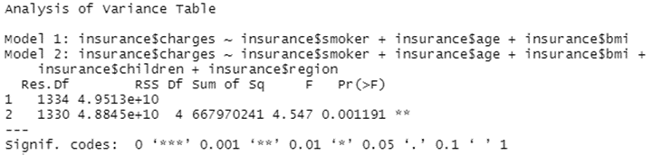
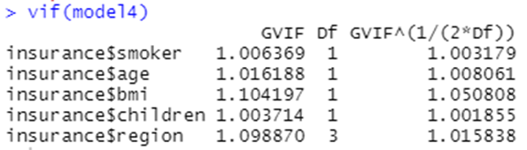
COMPARISON OF MODELS
DF of 4, indicating that the more complex model has four additional parameters and a very small p-value, which means adding on the variables children and region has led the model to have a significantly improved fit over the initial model.
To check the assumption of multicollinearity, one of the methods that can be applied is the variance inflation factor (VIF).
the VIF should not be higher than 10, which our results shown likewise.

Slide 18
THANK YOU

